Slide 1
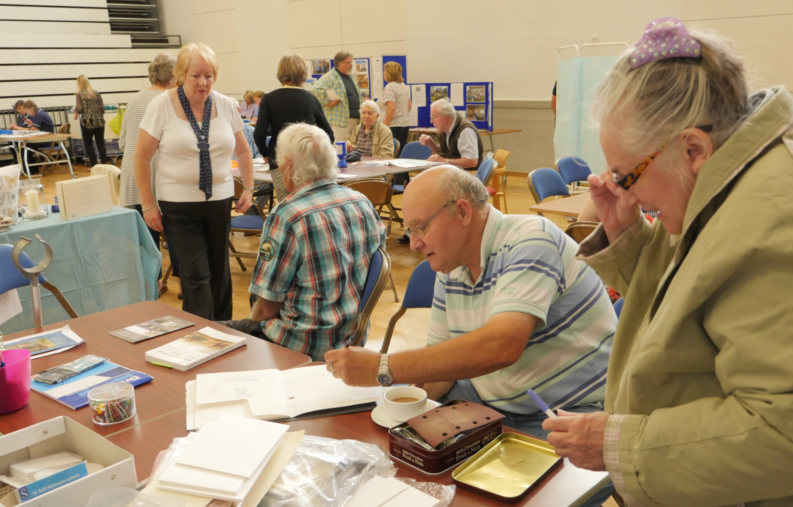
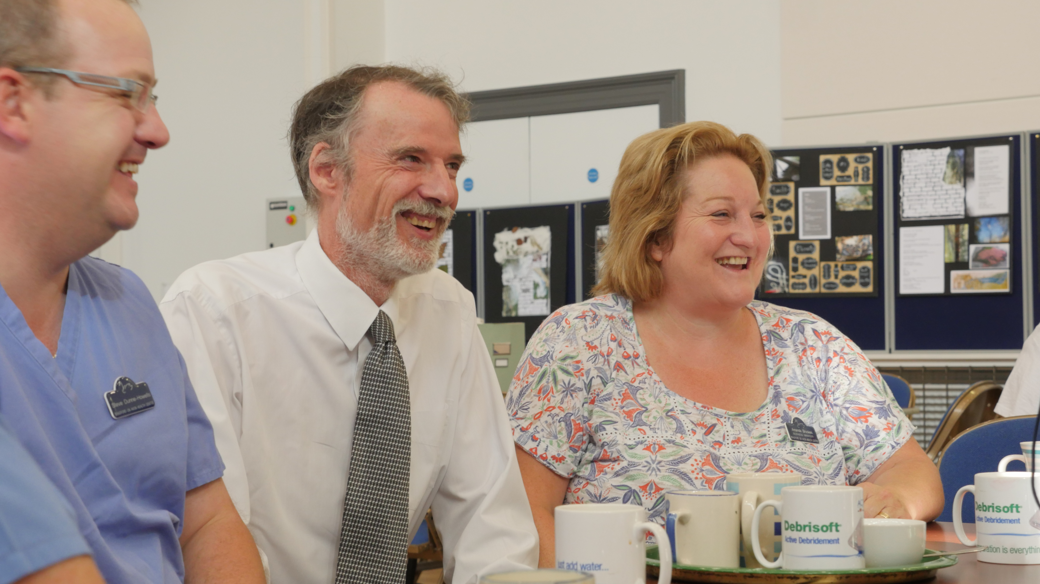
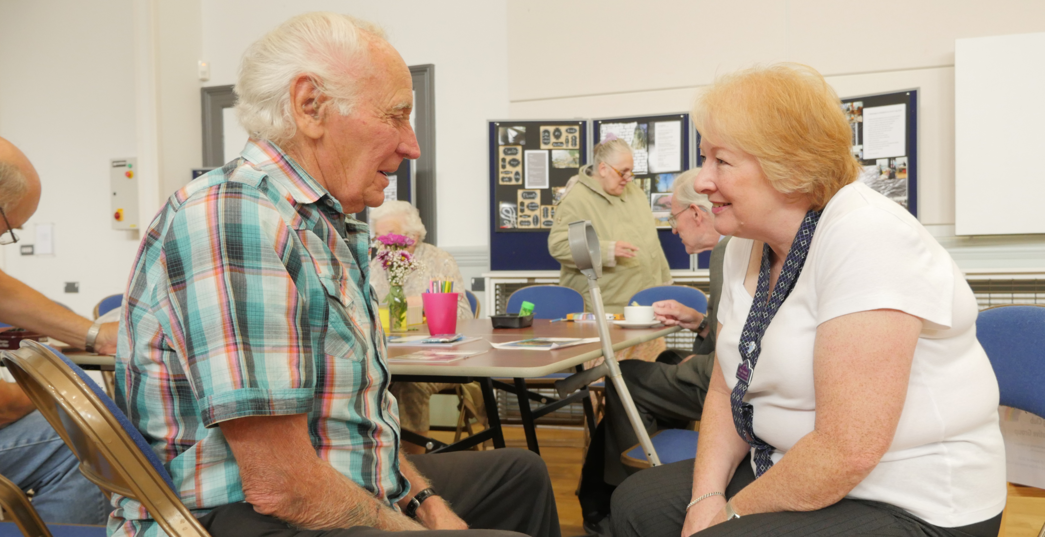
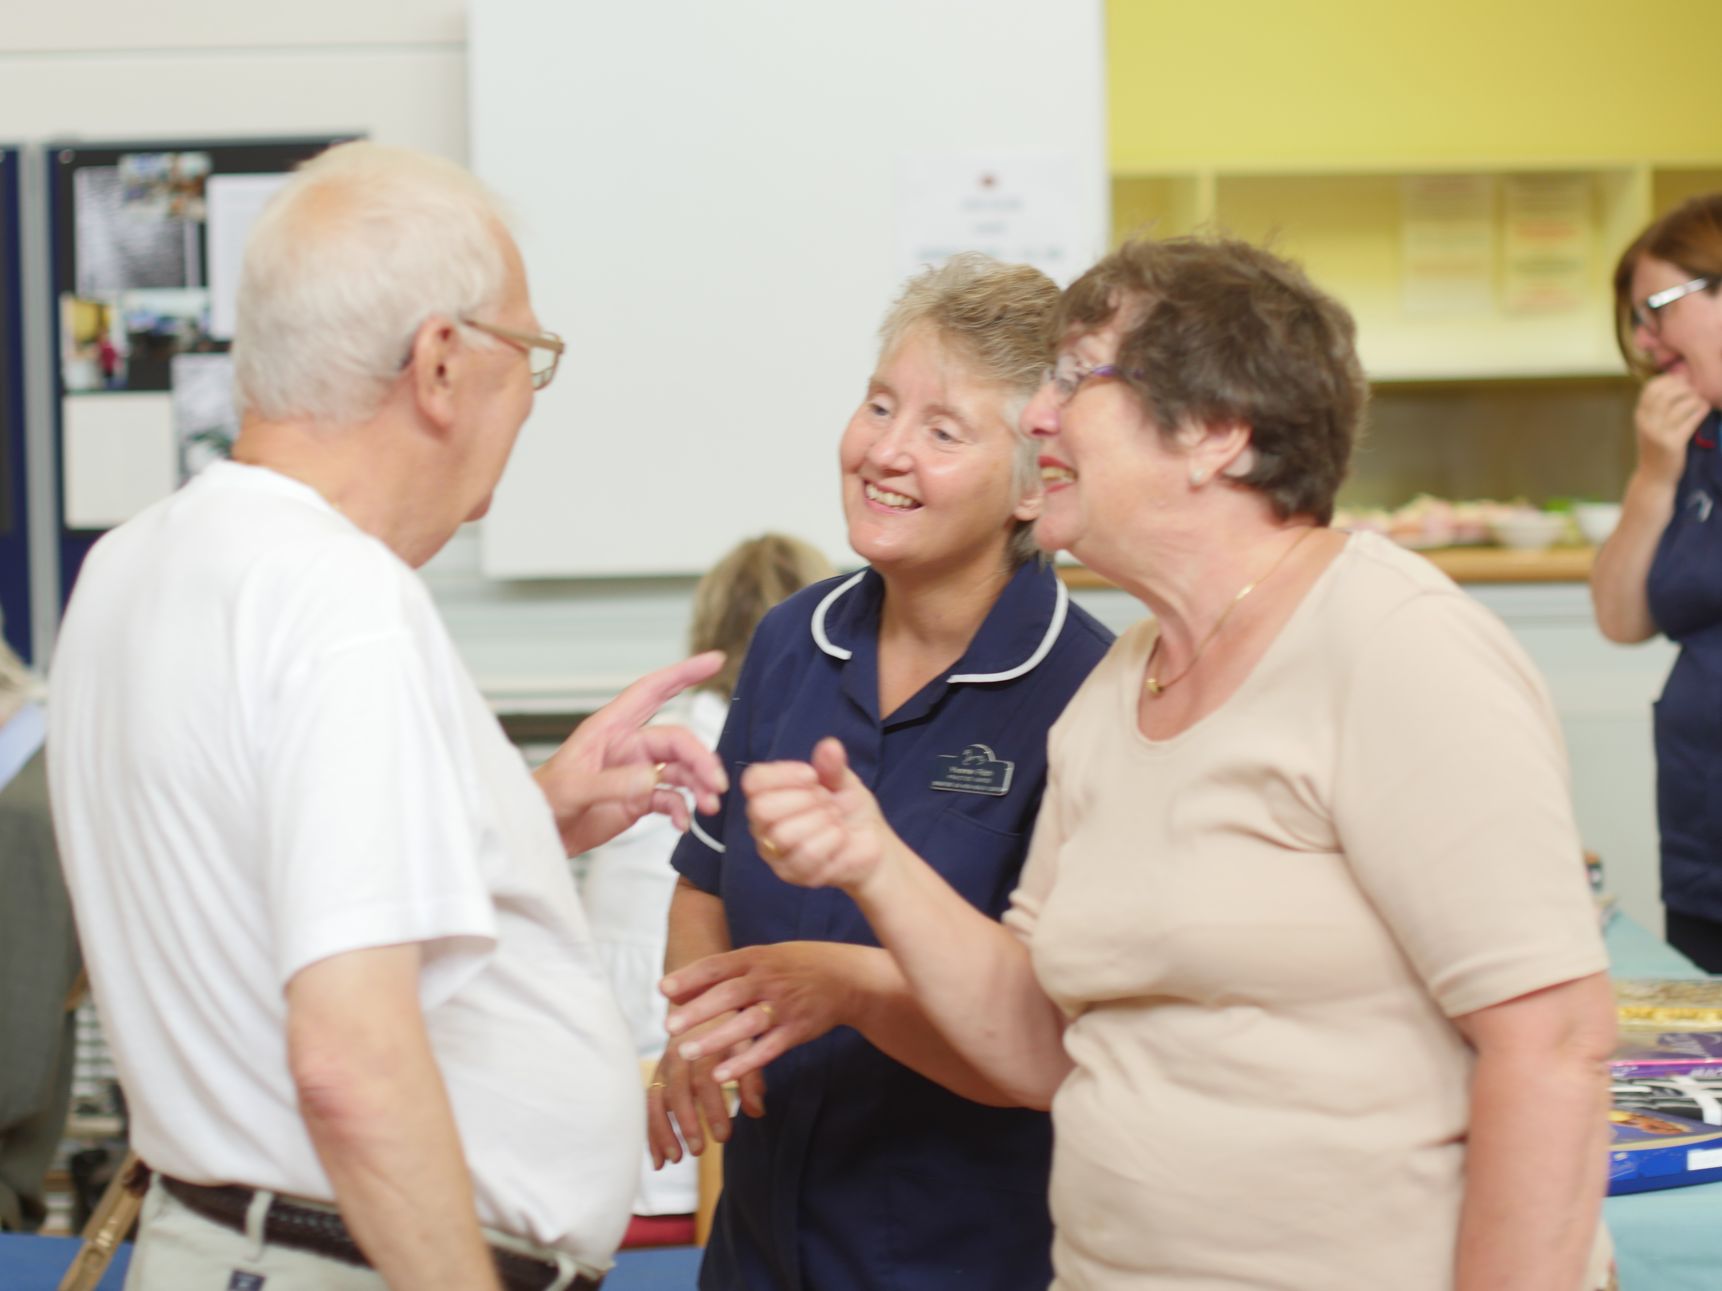
Is health prevention in a social environment the way forward for lower limb care? Ellie Lindsay, OBE FQNI, Visiting Fellow, Queensland University of Technology and Joan-Enric Torra PhD, University of Lleida, Spain
Of the many decisions facing the healthcare profession today, those concerned with the objective of improving public health prevention of the lower limb and education will ultimately prove to be the greatest possible benefit to the improvement of person-centred care.
Community nursing, also known as public health nursing, is the art and science of preventing disease, prolonging life, promoting health, wellbeing and efficiency through a structured pathway of care, education, information and understanding.
The central theme of the progressive health promotion concept for individual wellbeing is the organisation of facilities, services and staff around the needs of the primary population.
The challenge, therefore, is to meet the new and ever growing demands being made in an innovative and cost-effective way.
Background
Many people with problems of the lower limb and leg ulcers are elderly, poor and alone. The disorder brings much suffering to the individual being treated for leg ulcers and who is experiencing comorbidity. Leg ulcer management presents a number of global challenges. First, it is costly in terms of nursing resource and wound care dressings. Second, healing time is protracted and recurrence rates are high. Third, there is often little help available in the form of support and advice on prevention of the lower limb and leg ulcers.
With increasing age the prevalence of chronic leg ulceration becomes more common. Ulcers can persist and reoccur causing physical and emotional distress for those who have the ulcer and those who care for them. Health beliefs play an important part when treating and managing individuals with leg ulcers, and many have lived with open wounds for many years. They have, therefore, been through endless cycles of healing and breakdown, with each cycle lasting many weeks or months. Those factors can contribute to depression, loss of esteem, social isolation, loss of income and self-neglect.
The social Leg Club model attempts to address the broader influences on health, social, cultural, environmental and economic factors as opposed to just disease and injury. That may be achieved by personal and direct involvement through observation, participation or an activity designed to facilitate health promotion learning in a social Leg Club setting. The value of interacting with individuals who are ‘living the experience’ has far greater impact then merely theorising. It is experience that gives theories significance making them vital and verifiable.
Method
From its inception in 1995 the Leg Club, an innovative and evidence-based initiative, has specifically drawn from the discipline of health psychology to promote health education through psychology, biology, sociology, social interaction and high standards of professional communication. All are necessary and important components of effective care, sitting alongside the more traditional features of community-based treatment and cure. The Leg Club philosophy recognised the need to move the concentration away from ‘clinical’ and ‘illness’ and the preoccupation with pathology, repairing damage and other downsides of human existence to explicating those processes that support what is pro-social, productive and fulfilling. Health promotion is the process or activity that facilitates the protection or improvement of the health status of individuals, groups and communities. Its objective is to prolong life, improve the quality of life and reduce the effects of impaired physical health. The three main approaches to preventative health promotion within a social Leg Club environment are:
Behaviour change: primarily aimed at bringing about changes in individual behaviour through changes in the individual’s cognition and increasing the individual’s knowledge and understanding about health risks, hazards and illness. The goal is to reframe possible negative behaviours to positive wellness actions.
Self-empowerment: sets out to empower individuals to make healthy choices through participatory learning techniques. Individuals are taught to increase control over their physical, social and internal environment.
Collective action: here communities of individuals work collaboratively to modify those social, economic and physical structures which may generate ill health (Lindsay and Hawkins, 2007).
Results
Effective communication is a key component in promoting public health education. It provides the basis for the development of a dynamic therapeutic and educative process in preparation for meeting the health needs of society. Practitioners have to accept and understand that both science and art have equal importance in interaction and the building of a therapeutic relationship, which are necessary when imparting health promotion information. The ‘well leg’ programme at the Leg Club is an integral part of the social model and is aimed at health education, advice, maintenance and prevention of further leg-related problems once an ulcer has healed.
Prevention and intensive prevention management are key in the condition and recent reports from the Leg Club database confirm that the main clinical reason for attending Leg Clubs is not simply treatment of an ulcer but to receive ‘advice and maintenance’. The majority of members (56% between 1st April 2017–31st March 2018) were in the ‘Well Leg’ rather than the ‘treatment’ bracket, which means that they were being monitored and advised rather than treated.
Discussion
Successful introduction of health promotion requires clear objectives, a well defined strategy with realistic and achievable goals, and good communication. Throughout its growth and development the Leg Club has drawn on all three approaches to promote the wellbeing of its patients (known as members). To date the key objective has been the management of leg ulcers and the promotion of well legs for those members who attend.
Nursing staff work together with members in a unique partnership. They adhere to best practice guidelines, providing interactive teaching and learning and draw on the self-empowerment approach to health promotion, where shared knowledge facilitates an open forum. To date, over 12,000 Leg Club members have been encouraged and enabled through the interactive learning process to get to ‘know their own legs’ and with that new knowledge and understanding collaborate in their management. Hence, every member receives an informative Members Handbook. In working alongside and supporting the individual members and their families, and providing educational talks within the Clubs local communities, improved knowledge and understanding is guaranteed.
Conclusion
Evidence-based health promotion is a priority and as practitioners we have a responsibility to change the trajectory of lower limb management to ensure higher quality information while not disrupting innovation and creativity. Researchers and practitioners, therefore, should be challenged and reassured by the prospect of developing new ways to deliver evidence-based health promotion of lower limb care in partnership with their client group and the general public.
The extended skills of the self-empowerment approach to prevention and self-care, including participatory learning, problem solving, group work, education, information and advice, supplemented by person-centred direction which forms the basis of the day-to-day care delivered by Leg Club teams, are being offered to a wider, national audience. The processes and principles which are shared should include values, planning, action and reflection and we need to unite and work in partnership with various disciplines and research organisations, not in isolation!
Expansion of health promotion now includes raising awareness of preventative management of all aspects of lower limb related problems to the general public. Continuous Leg Club health promotion initiatives have seeded the community with excellence in practice and ensured that widely differing groups have been given access to Well Leg management, from leather-clad motorcycle riders to pregnant mothers.
The Leg Club text and logo are registered trademarks in the UK

